Slide 1

CMR TECHNICAL CAMPUS
Department of Information Technology
Major Project Stage 2
Review-2
Project Title: NLP-based Analysis of Cyber Threats and Vulnerabilities of
The Healthcare Ecosystem
Project Supervisor:
Name: G. Menaka
Designation: Assistant Professor
Presented By:
Batch No. :04
1. | H.No: 227R1A1281 | Name: D.Sruthi
2. | H.No: 237R5A1207 | Name: Md.Samiuddin
3. | H.No: 227R1A12C1 | Name: P. Nitheesh

Slide 2
AGENDA
Modules
UML Diagrams
Source Code
Results
Conclusions & Future Enhancement
References
Github
Introduction And Overview Of The Project
Existing System
Disadvantages
Proposed System
Advantages
Hardware And Software Requirements
Novelty Of The Project
Architecture

Slide 3
INTRODUCTION AND OVERVIEW OF THE PROJECT
• An NLP-based framework designed to analyze textual descriptions of cyber incidents, predict threat categories, assess severity levels, and recommend suitable defense mechanisms.
• The raw dataset, consisting of unstructured textual reports, was preprocessed through tokenization, stop word removal, and lemmatization to ensure clarity and consistency.
• For the feature extraction, An Decoding-enhanced BERT with disentangled attention (DeBERTa) transformer embeddings were generated, providing semantically rich, high-dimensional representations of incident reports.
• To mitigate class imbalance, balancing techniques such as random resampling and Synthetic Minority Oversampling Technique (SMOTE) were applied across multiple target labels.
• Multiple machine learning models were employed, with the Greedy Tree-based classifier emerging as a reliable and interpretable solution for this application.

Slide 4
EXISTING SYSTEM
• Current systems rely heavily on manual threat reporting and rule-based monitoring approaches.
• Security analysts manually sift through cyber incident logs and textual descriptions to identify risks.
• The lack of effective data management makes it difficult for individuals to control potential risks.
• Existing algorithms in traditional cybersecurity solutions, while effective in certain domains, often fail to process unstructured textual data in a contextual and scalable manner.
• Service providers like social networks and cloud storage store user data for sale, leaving users without control over their data.

Slide 5
DISADVANTAGES OF EXISTING SYSTEM
Error-prone, and unable to the scale up large data volumes of healthcare.
Privacy is not well protected.

Slide 6
PROPOSED SYSTEM
• Machine Learning: The proposed system integrates NLP with machine learning models and algorithms (DEBERT) to automate the analysis of cyber threats in healthcare..
• AI: A secure computing platform that generates intelligent security rules. It checks if the user has permission to access shared data, detects vulnerabilities unique to healthcare systems.
• NLP Preprocessing: First, textual incident descriptions are preprocessed using tokenization, stopword removal, and lemmatization, ensuring standardized input data, next EDA techniques, such as word frequency and part-of-speech analysis, provide insights into the linguistic structure of threats.

Slide 7
ADVANTAGES
Provides more data security compared to previous system.
Enhances patient safety and trust by ensuring continuous protection of sensitive healthcare data and systems.
Handles large data efficiently, understands threat context better.

Slide 8
SOFTWARE & HARDWARE REQUIREMENTS
SOFTWARE REQUIRMENTS :
Front end Technologies
Back end Technologies
Framework
Database
HARDWARE REQUIRMENTS :
Processor
Hard Disk
RAM
:
:
:
:
Html, CSS
Python
Django
MySQL
:
:
:
Pentium IV or higher
minimum 512MB
256 MB

Slide 9
NOVELTY OF THE PROJECT
• Utilizes Natural Language Processing to analyze unstructured cyber threat information in healthcare. • Proactively identifies early warning signals of potential cyber attacks. • Understands the context of healthcare domains including Electronic Health Records (EHRs), medical devices, and clinical workflows. • Connects cyber vulnerabilities with patient safety and care continuity. • Transforms unstructured data into actionable threat intelligence. • Provides a domain-aware and adaptive cybersecurity solution tailored to the healthcare ecosystem.

Slide 10
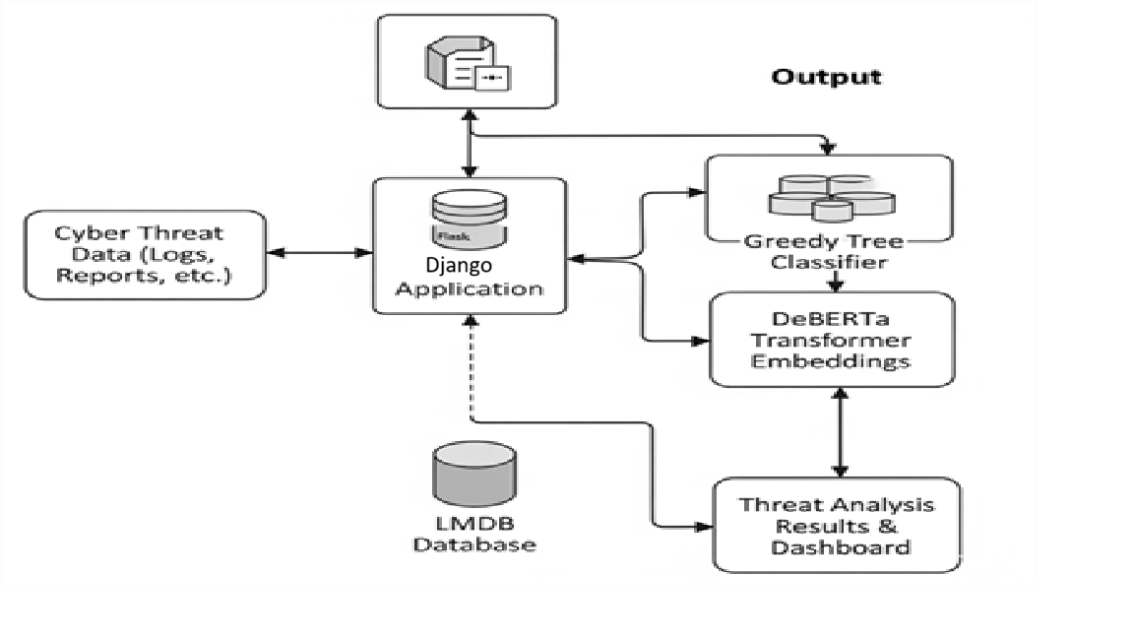
SYSTEM ARCHITECTURE

Slide 11
MODULES
• Data Acquisition Module: Gathers cybersecurity - related text data from diverse sources such as a threat intelligence feeds (CVE, NVD), healthcare incident reports, research articles, and online forums. This module ensures the system has comprehensive and up-to-date threat information for analysis.
• Data Pre-processing Module: Cleans and prepares the collected text by removing noise, duplicates, and irrelevant content. It performs tokenization, stopword removal, and lemmatization to standardize the text and make it suitable for NLP processing.
• NLP Feature Extraction Module: Converts pre processed text into numerical form using an techniques like TF-IDF, Word2Vec, or BERT embeddings. This enables the system to understand and process textual data for machine learning and deep learning models.

Slide 12
MODULES
• Threat Classification and Vulnerability Mapping Module: Classifies extracted information into categories (e.g., ransomware, phishing, DDoS) and maps identified threats to known vulnerabilities (e.g., CVEs). This helps in understanding which healthcare assets or systems are at risk.
• Threat Analysis and Visualization Module: Analyzes patterns, trends, and severity levels of detected threats over time. It visualizes insights through dashboards and charts, helping cybersecurity professionals monitor emerging threats and make informed decisions.

Slide 13
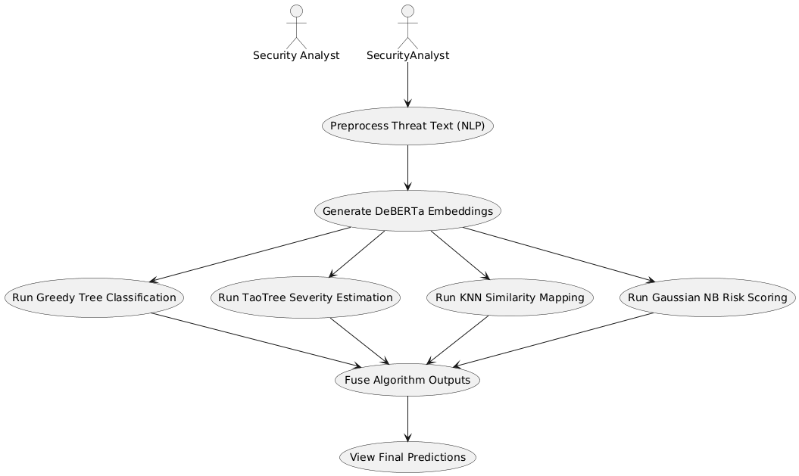
UML DIAGRAMS
Use Case Diagram

Slide 14
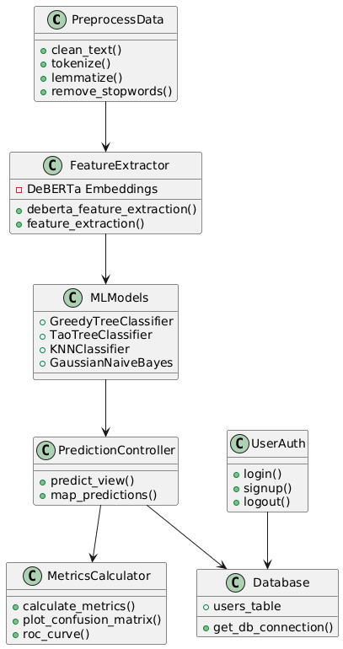
UML DIAGRAMS
Class Diagram

Slide 15
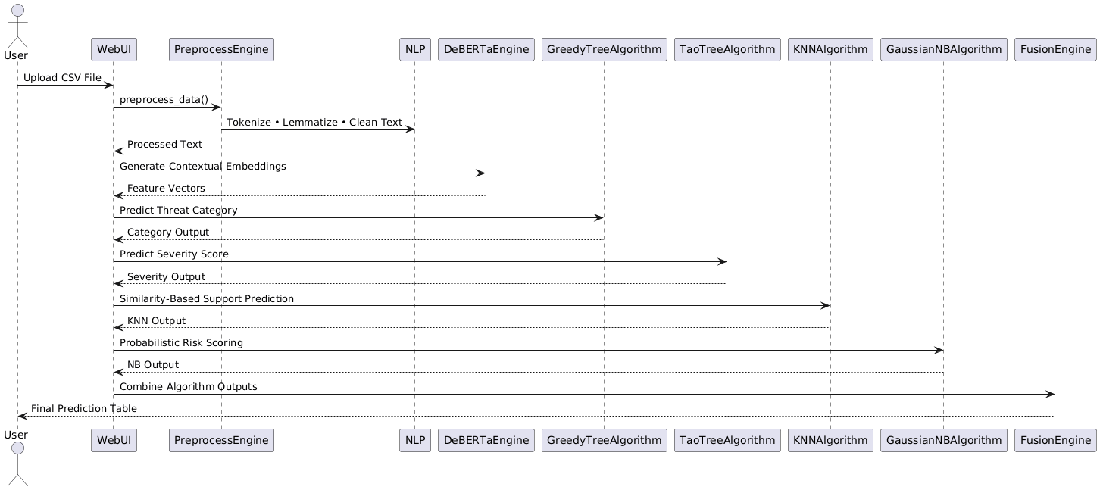
UML DIAGRAMS
Sequence Diagram

Slide 16
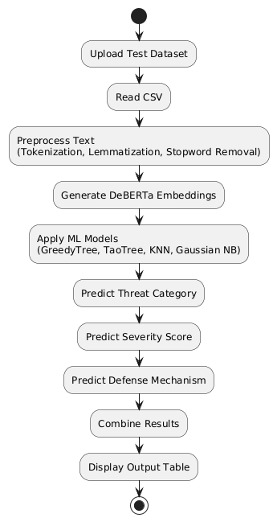
UML DIAGRAMS
Activity Diagram

Slide 17
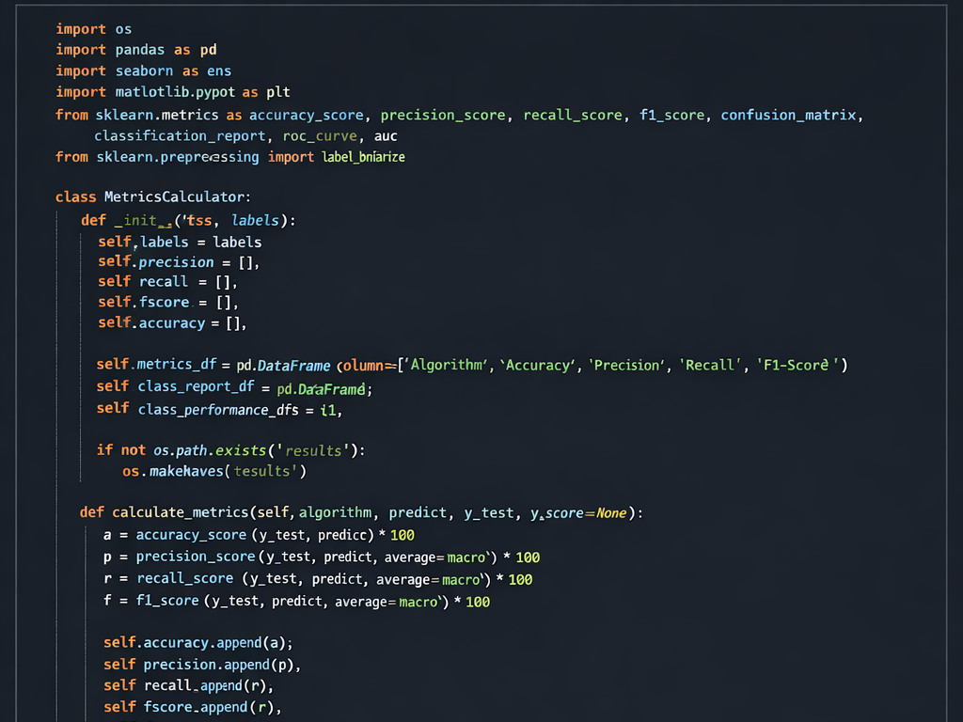
SOURCE CODE

Slide 18
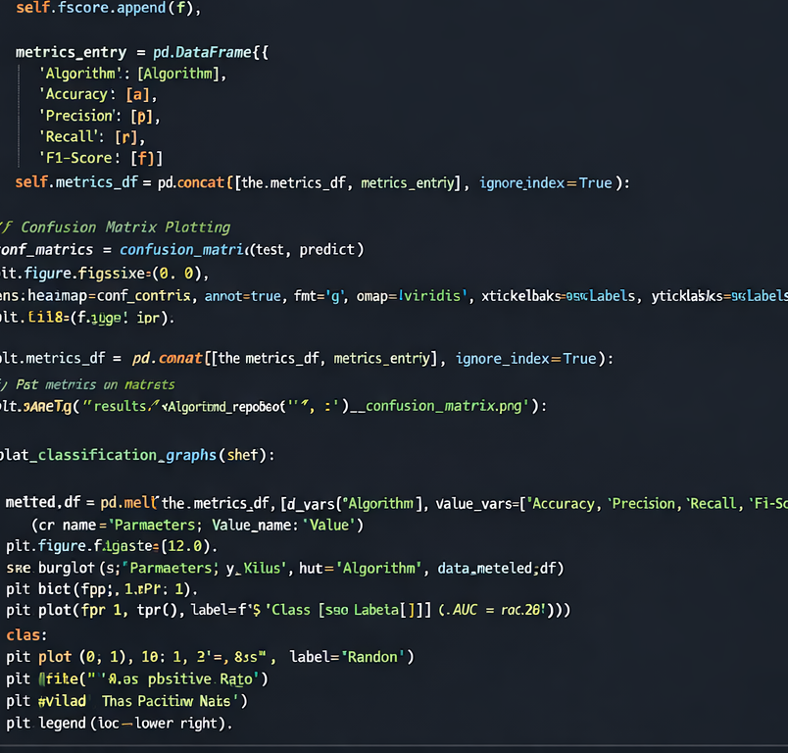
SOURCE CODE

Slide 19
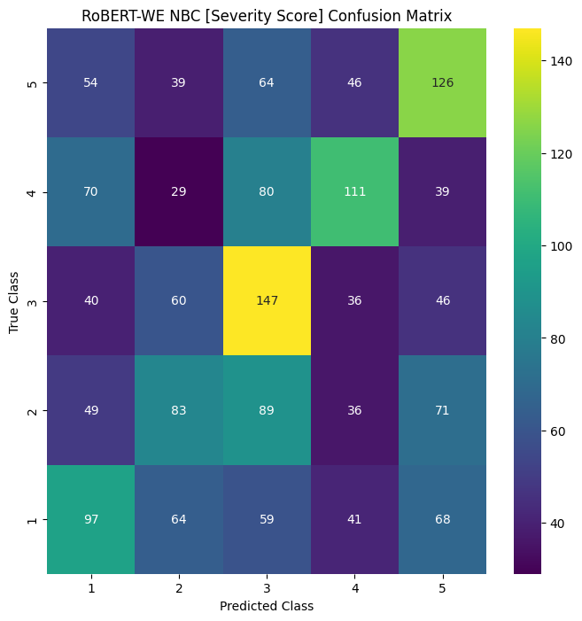
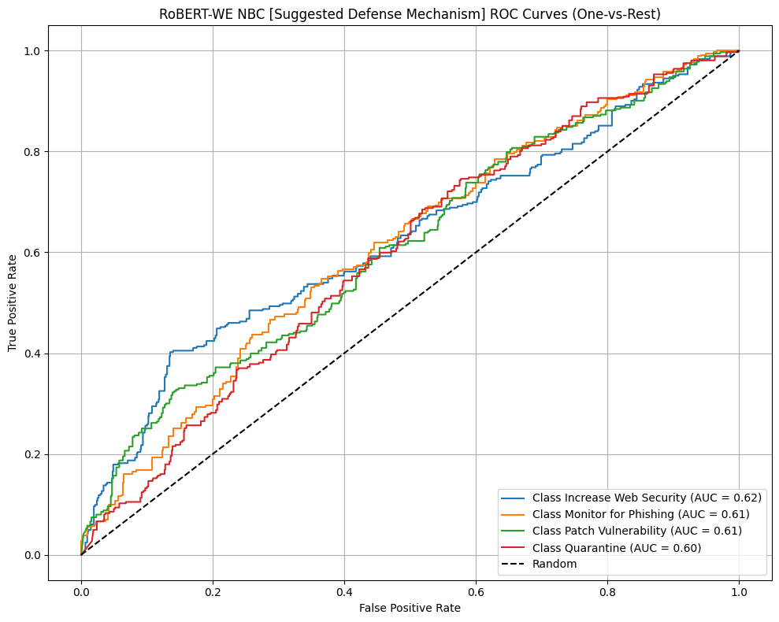
RESULTS

Slide 20
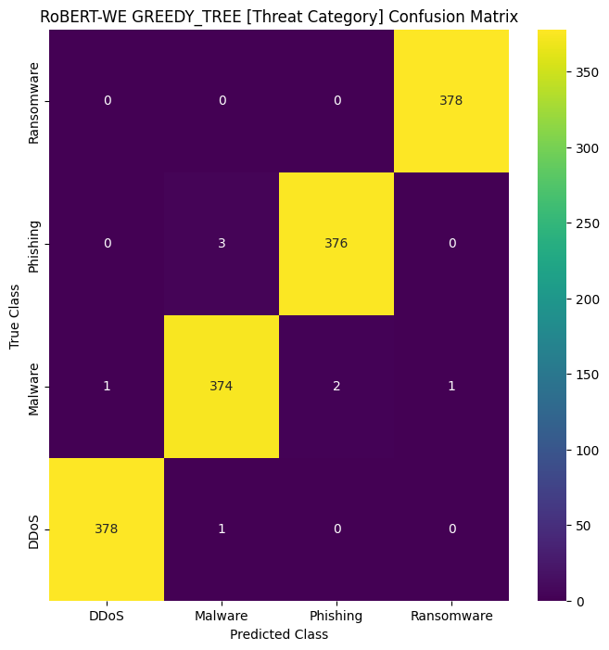
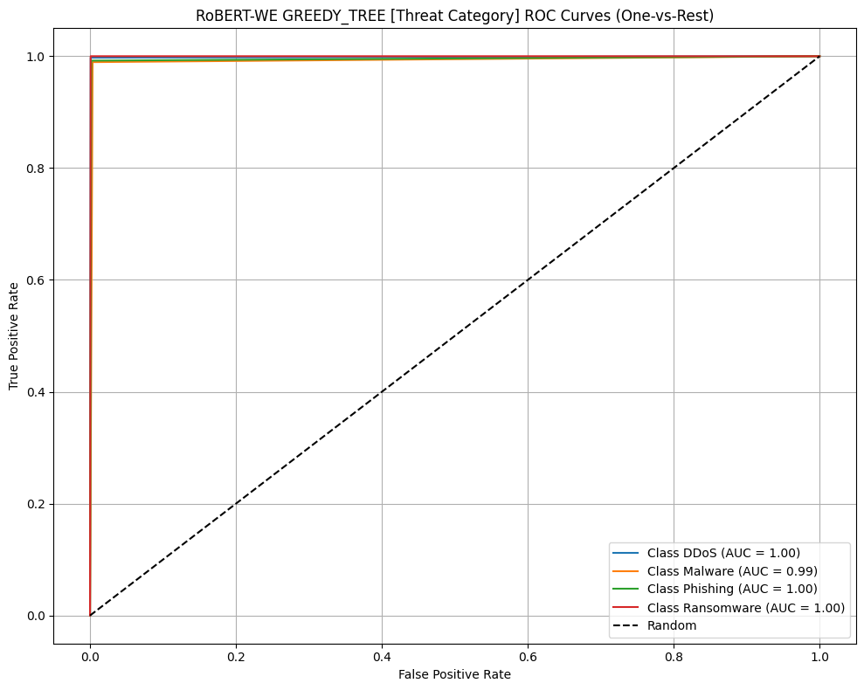
RESULTS

Slide 21
RESULTS
Algorithm | Accuracy (%) | Precision (%) | Recall (%) | F1-Score (%)
KNN | 78 – 82 | 75 – 80 | 74 – 79 | 75 – 79
Gaussian Naive Bayes | 80 – 84 | 78 – 83 | 77 – 82 | 78 – 82
TAO Tree Classifier | 88 – 92 | 86 – 91 | 85 – 90 | 86 – 90
Greedy Tree | 90 – 95 | 89 – 94 | 88 – 93 | 89 – 93

Slide 22
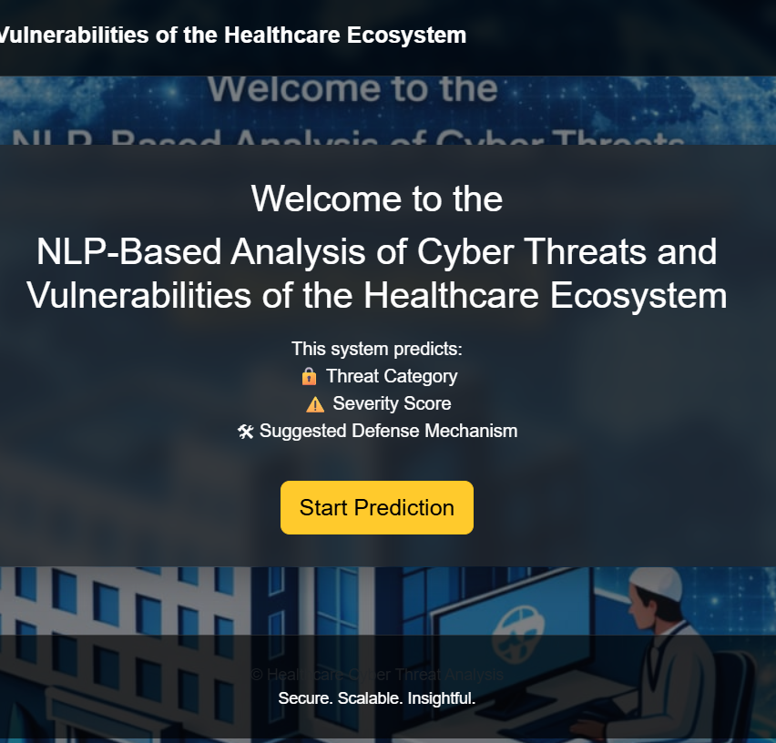
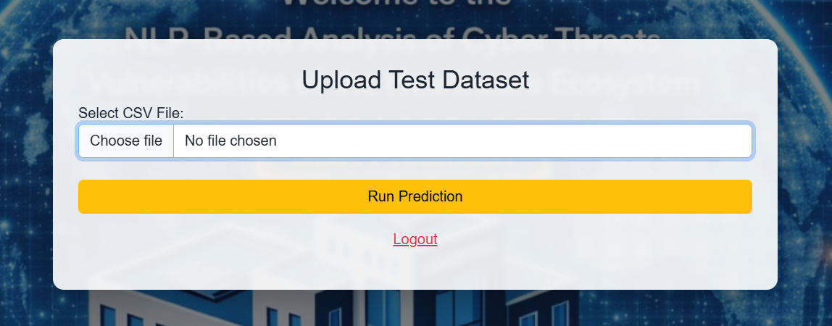
RESULTS

Slide 23
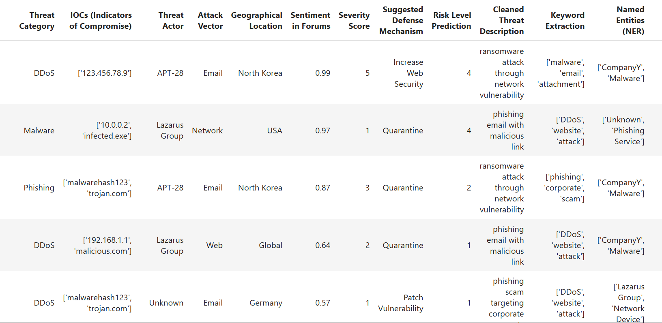
RESULTS

Slide 24
CONCLUSION & FUTURE ENHANCEMENT
The system uses Natural Language Processing (NLP) to analyze large volumes of unstructured cybersecurity text and identify potential threats in healthcare systems.
Text data is preprocessed using tokenization, stop-word removal, and lemmatization, and contextual features are extracted using the DeBERTa transformer model to capture deeper semantic meaning.
Machine learning classifiers such as Greedy Tree, TaoTree, K-Nearest Neighbors, and Gaussian Naive Bayes are trained, where the Greedy Tree model provides the best predictive performance.
The framework improves automation, speed, and accuracy of cyber-threat detection, helping analysts detect risks early and strengthen healthcare cybersecurity.

Slide 25
REFERENCES
Ghaffarian, S.M.; Shahriari, H.R. Software Vulnerability Analysis and Discovery Using Machine-Learning and Data-Mining Techniques: A Survey.
Satyapanich, T.; Ferraro, F.; Finin, T. CASIE: Extracting Cybersecurity Event Information from Text. In Proceedings of the Thirty-Fourth AAAI Conference on Artificial Intelligence, AAAI 2023, the Thirty-Second Innovative Applications of Artificial Intelligence Conference, IAAI 2023, New York, NY, USA, 7–12 February 2023; AAAI Press: Palo Alto, CA, USA, 2023; pp. 8749–8757.
Gao, C.; Zhang, X.; Liu, H. Data and knowledge-driven named entity recognition for cyber security.

Slide 26
GITHUB LINK
https://github.com/mohammedsami015/Batch-4-NLP-based-analysis-of-cyber-threats-and-vulnerabilities-of-healthcare-ecosystem.git

Slide 27


